Slide 1

GOVERNMENT ENGINEERING COLLEGE KUSHALNAGAR
DEPARTMENT OF COMPUTER SCIENCE AND ENGINEERING PROJECT PRESENTATION FROM:
DURGA S
PARAMESHA C M
CHAITHRA M
VINMAY KUMAR
( 4GL20CS006 ) (4GL20CS018) (4GL21CS402) (4GL21CS415)
UNDER THE GUIDANCE OF Prof. RADHIKA B.E, MTech
Assistant Professor Dept of CSE, GECK

Slide 2
CONTENTS
INTRODUCTION
PROBLEM STATEMENT
LITERATURE SURVEY
OBJECTIVE
EXISTING SYSTEM
PROPOSED SYSTEM
ARCHITECTURE
FLOW OF PROPOSED SYSTEM
RESULTS AND DISCUSSION
SNAPSHOTS
LIST OF MODULES
CONCLUSION
REFERENCES

Slide 3
INTRODUCTION
Drug addiction is a complex and pervasive public health issue affecting individuals worldwide. Despite efforts to combat addiction, effective treatment strategies remain a challenge. The integration of advanced therapeutic approaches, such as mindfulness-oriented interventions and neuroplasticity-based therapies, shows promise in addressing the multifaceted nature of addiction.

Slide 4
PROBLEM STATEMENT
Traditional addiction treatments often focus solely on symptom management, overlooking underlying psychological and neurobiological factors contributing to substance use disorders. This gap highlights the need for innovative interventions that target both the physiological and psychological aspects of addiction.

Slide 5
LITERATURE SURVEY
S.No | Title | Author | Year | Methodology | Inference | Merits | Limitations
1 | Analysis of the | Holland, A., | 2023 | Keccak | Supports | Possible | A
 | UK | Stevens, A., |  |  | secure data | susceptibility | cryptographic
 | Government’s | Harris, M., |  |  | deletion and | to collision | hash function
 | 10-Year Drugs | Lewer, D., |  |  | data purging | attacks | known for its
 | Strategy—a | Sumnall, H., |  |  |  |  | security and
 | resource for | Stewart, D., ... |  |  |  |  | flexibility.
 | practitioners | & Hickman,
 | and | M.
 | policymakers
2 | Age of onset | McGrath, J. J., | 2023 | Piccolo | Protection | Challenges in | A lightweight
 | and cumulative | Al-Hamzawi, |  |  | against cloud | secure key | symmetric
 | risk of mental | A., Alonso, J., |  |  | service | generation and | encryption
 | disorders: a | Altwaijri, Y., |  |  | provider data | storage | algorithm
 | cross-national | Andrade, L. |  |  | disclosure |  | suitable for
 | analysis of | H., Bromet, E. |  |  |  |  | resource-const
 | population | J., ... & |  |  |  |  | rained devices.
 | surveys from | Zaslavsky, A.
 | 29 countries | M.

Slide 6
LITERATURE SURVEY
S.No | Title | Author | Year | Methodology | Inference | Merits | Limitations
3 | Buprenorphine | Degenhardt, L., | 2023 | AEGIS | Enables secure | Risk of data | A lightweight
 | versus | Clark, B., |  |  | data integration | exposure during | encryption
 | methadone for | Macpherson, |  |  | and federation | data | algorithm
 | the treatment of | G., Leppan, O., |  |  |  | synchronization | designed for
 | opioid | Nielsen, S., |  |  |  |  | efficient
 | dependence: a | Zahra, E., ... & |  |  |  |  | authenticated
 | systematic | Farrell, M. |  |  |  |  | encryption.
 | review and
 | meta-analysis
 | of randomised
 | and
 | observational
 | studies
4 | Agreement | Bharat, C., | 2023 | Rectangling | Enables secure | Challenges in | A lightweight
 | between | Webb, P., |  |  | data masking | securing data | cryptographic
 | self‐reported | Wilkinson, Z., |  |  | and | during storage | permutation
 | illicit drug use | McKetin, R., |  |  | tokenization |  | designed for
 | and biological | Grebely, J., |  |  |  |  | security and
 | samples: a | Farrell, M., ... |  |  |  |  | performance.
 | systematic | & Degenhardt,
 | review and | L.
 | meta‐analysis

Slide 7
LITERATURE SURVEY
S.No | Title | Author | Year | Methodology | Inference | Merits | Limitations
5 | Epidemiology | Degenhardt, | 2023 | Shadow | Enables secure | Risk of data | A lightweight
 | of injecting | L., Webb, P., |  |  | data | exposure | symmetric
 | drug use, | Colledge-Frisb |  |  | anonymization | during data | encryption
 | prevalence of | y, S., Ireland, |  |  | and | validation | algorithm
 | injecting-relate | J., Wheeler, |  |  | de-identificatio |  | known for its
 | d harm, and | A., Ottaviano, |  |  | n |  | high security
 | exposure to | S., ... & |  |  |  |  | and low
 | behavioural | Grebely, J. |  |  |  |  | overhead.
 | and
 | environmental
 | risks among
 | people who
 | inject drugs: a
 | systematic
 | review

Slide 8
OBJECTIVES
Comprehensive Assessment: Develop a system that enables comprehensive assessment of individuals with substance use disorders, including their neurocognitive functioning, addiction severity, and psychological profiles.
Personalized Intervention: Implement personalized interventions tailored to each individual's specific needs and response profiles, leveraging insights from mindfulness-oriented therapies, cognitive stimulation techniques, and neurostimulation.
Holistic Treatment Approach: Offer a holistic treatment approach that addresses both the symptoms and underlying mechanisms of addiction, aiming to promote sustained recovery and reduced risk of relapse.

Slide 9
OBJECTIVES
Outcome Monitoring and Adaptation: Establish a framework for continuous outcome monitoring, allowing for real-time adaptation of interventions based on patient progress, preferences, and therapeutic responses.
Efficacy Evaluation: Evaluate the efficacy of the integrated therapeutic approach in improving addiction treatment outcomes, including reductions in substance use, improvements in neurocognitive functioning, and enhanced psychological well-being.

Slide 10
EXISTING SYSTEM
The existing addiction treatment systems often focus primarily on symptom management through traditional approaches such as medication and behavioral therapies. However, these systems often lack comprehensive integration of neurobiological and psychological principles, leading to limited effectiveness in addressing the underlying causes and complexities of addiction. Moreover, traditional treatments may not adequately address individual differences in neurocognitive functioning, psychological factors, and treatment response profiles.

Slide 11
EXISTING SYSTEM
This can result in suboptimal outcomes, including higher rates of relapse and ongoing challenges in achieving sustained recovery. Additionally, access to specialized addiction treatment services may be limited, further exacerbating the shortcomings of the existing system and highlighting the need for more innovative and personalized approaches to addiction care.

Slide 12
PROPOSED SYSTEM
The proposed system aims to analyze the drug-dependent population by creating a sophisticated digital platform that combines a user-friendly Streamlit interface, advanced natural language processing through OpenAI's GPT-3 integration, and a robust backend database for data management. This system will facilitate therapeutic interactions, offering personalized therapy sessions and medical report generation, thus enabling dynamic, empathetic communication with users seeking help for drug addiction. The architecture also includes secure user authentication and a feedback mechanism to refine and enhance the user experience continuously.

Slide 13
PROPOSED SYSTEM
This approach offers several advantages over traditional methods, including improved treatment efficacy, reduced risk of relapse, and enhanced overall well-being by addressing the complex interplay of neurobiological, psychological, and behavioral factors contributing to addiction. Additionally, the use of innovative technologies and personalized treatment plans can optimize patient engagement and adherence, leading to better long-term outcomes and increased accessibility to effective addiction care. Ultimately, the proposed system represents a promising advancement in addiction treatment by offering a more tailored and integrated approach to addressing the multifaceted nature of substance use disorders.

Slide 14
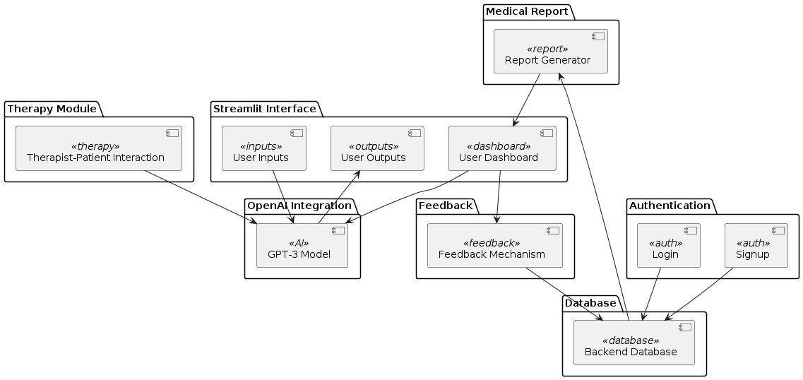
ARCHITECTURE

Slide 15
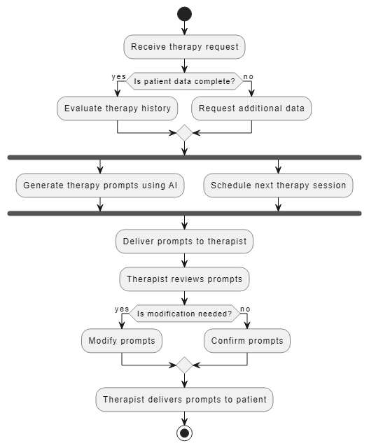

Slide 16
FLOW OF PROPOSED SYSTEM
User Interaction: Users securely log in to access therapy sessions and engage in dynamic conversations with the AI therapist.
Therapy Sessions:AI-driven therapy sessions use empathetic prompts tailored to gather information on addiction history and symptoms.
Data Collection and Analysis: User responses are collected and analyzed to generate personalized medical reports and treatment recommendations.

Slide 17
FLOW OF PROPOSED SYSTEM
Medical Report Generation: Comprehensive medical reports are generated based on user-provided information and AI-driven insights.
Continuous Improvement: System performance is continuously evaluated based on user feedback, leading to ongoing enhancements and optimizations.

Slide 18
RESULTS AND DISCUSSION
The proposed project on an integrated therapeutic system for addiction treatment intersects with several key areas in healthcare and research. This project leverages artificial intelligence (AI) technologies, including natural language processing (NLP) and machine learning, to enhance personalized treatment interventions and decision-making processes in addiction therapy. It aligns with digital health and telemedicine by utilizing digital platforms and telehealth services to broaden access to addiction treatment, especially in remote or underserved areas. Additionally, the project integrates mindfulness-based therapies, neurostimulation techniques, and cognitive remediation, emphasizing individualized and holistic approaches to address substance use disorders.

Slide 19
RESULTS AND DISCUSSION
It contributes to discussions on patient-centered care and personalized medicine, focusing on tailoring interventions based on unique patient characteristics and preferences. Ethical considerations around healthcare ethics and AI governance are paramount to ensure responsible use of AI technologies in addiction treatment, upholding patient privacy and data security. By engaging with these related areas, the proposed project aims to advance addiction treatment by integrating cutting-edge technologies with evidence-based therapeutic approaches to improve patient outcomes and promote recovery.

Slide 20
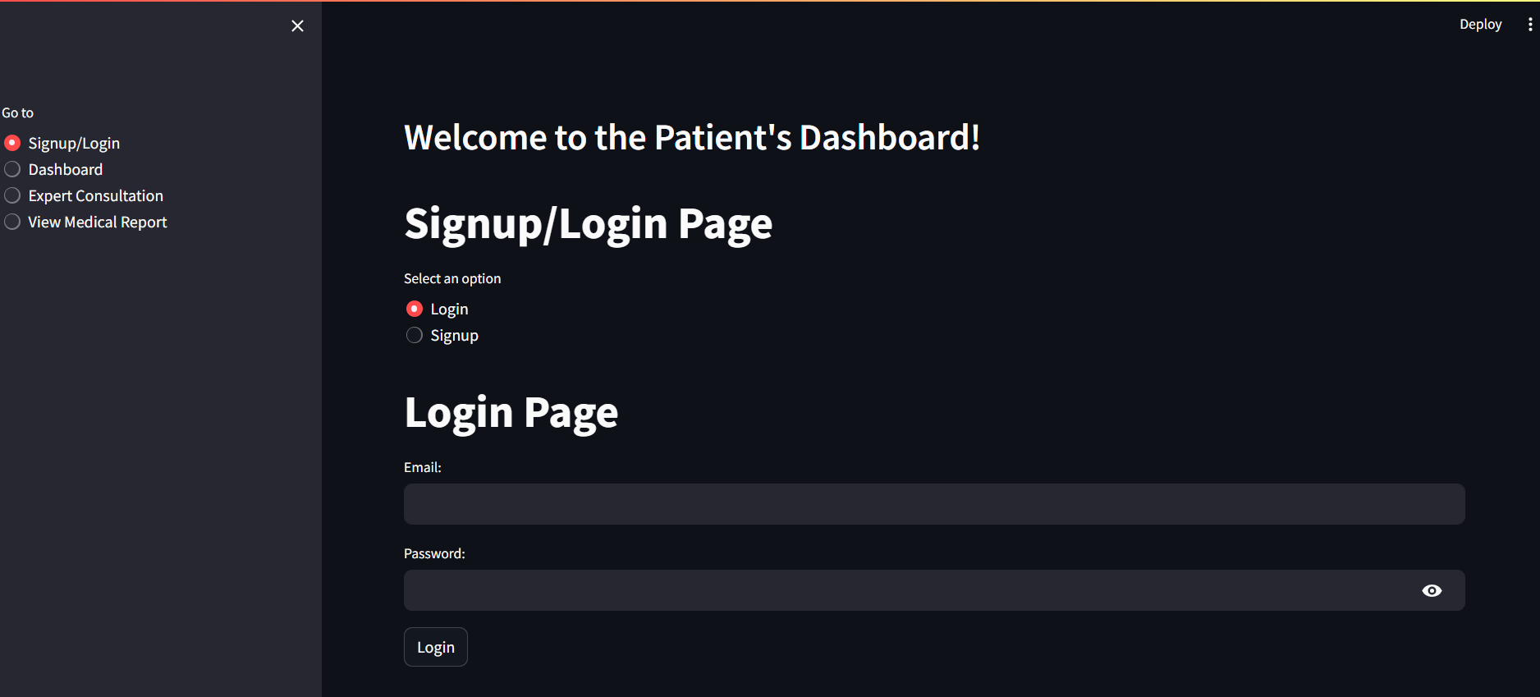
SNAPSHOTS
Figure 1: Home Page Snapshot

Slide 21
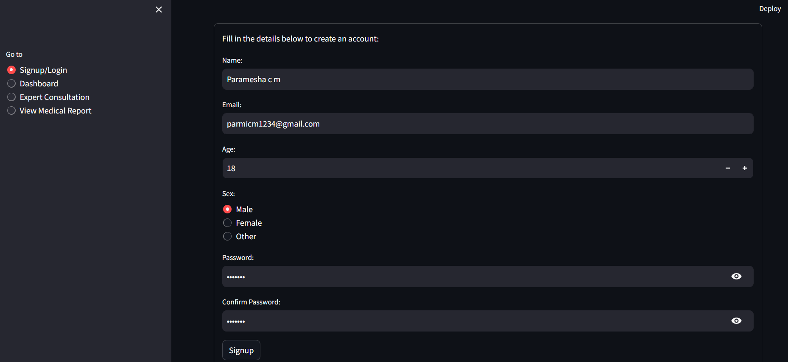
Figure 2: signup page

Slide 22
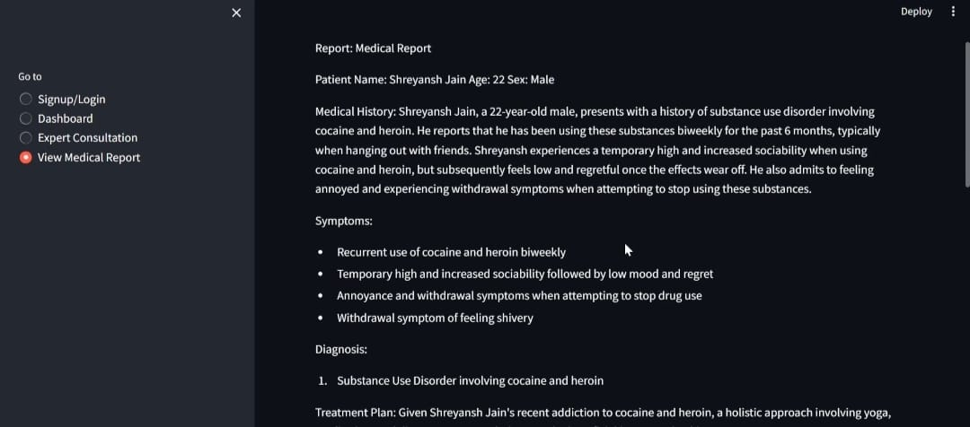
Figure 3: medical report

Slide 23
LIST OF MODULES
Data Collection
Intervention Selection
Personalized Therapy Delivery
Outcome Monitoring and Adaptation

Slide 24
LIST OF MODULES
Data Collection:
This module is responsible for gathering comprehensive data from users, including addiction history, current symptoms, lifestyle factors, and treatment preferences.
Data collection methods may involve structured assessments, user-provided information during therapy sessions, and potentially data integration from external sources (e.g., electronic health records) to enrich user profiles.
The collected data forms the basis for personalized treatment planning and analysis within the therapeutic system

Slide 25
LIST OF MODULES
Intervention Selection:
Once data is collected, this module utilizes AI-driven algorithms to analyze user information and determine appropriate interventions based on evidence-based guidelines and treatment protocols.
Intervention selection involves matching user profiles with tailored therapeutic approaches, considering factors such as addiction severity, co-occurring conditions, and individual preferences.
The module facilitates decision-making in therapy planning by recommending specific interventions, modalities, and strategies customized to each user's needs.

Slide 26
LIST OF MODULES
Personalized Therapy Delivery:
With intervention selection in place, this module enables the delivery of personalized therapy sessions and interventions through the therapeutic system.
Therapy delivery involves dynamic interactions between users and the AI therapist, presenting tailored prompts, exercises, and psychoeducation materials based on the selected interventions.
Personalized therapy delivery aims to engage users actively in their treatment, promote self-awareness, and foster therapeutic alliance through empathetic and effective communication strategies.

Slide 27
LIST OF MODULES
Outcome Monitoring and Adaptation:
Throughout the therapy process, this module continuously monitors user progress and outcomes using outcome measures, self-reported data, and feedback mechanisms.
Outcome monitoring involves assessing changes in addiction severity, symptomatology, and overall well-being over time to track treatment efficacy and identify areas for adaptation.
Based on outcome data and user feedback, the module supports adaptive therapy planning by adjusting interventions, modifying treatment goals, and optimizing therapeutic approaches to enhance treatment outcomes.

Slide 28
IMPLEMENTATION
1.Define Objectives and Scope: Begin by clearly defining the objectives of the analysis. Determine what specific aspects of the drug-dependent population you aim to analyze. This could include demographics, patterns of substance abuse, co-occurring disorders, access to treatment, etc. Define the scope of the analysis to ensure it remains focused and manageable.
2.Data Collection and Compilation: Identify sources of relevant data, including government databases, healthcare records, academic studies, and community surveys. Compile this data into a comprehensive dataset that covers the chosen scope of analysis. Ensure data integrity by verifying sources and employing quality control measures.

Slide 29
IMPLEMENTATION
Data Analysis and Interpretation: Utilize appropriate statistical and analytical methods to analyze the collected data. Identify key trends, patterns, and correlations within the drug-dependent population. Consider factors such as age, gender, socioeconomic status, geographic location, and types of substances abused. Interpret the findings to gain insights into the characteristics and needs of the population.
Report Generation: Prepare a detailed report summarizing the analysis findings. Clearly present the methodology used, key findings, and relevant conclusions drawn from the data analysis. Include visual aids such as charts, graphs, and maps to enhance understanding. Provide recommendations for addressing identified challenges and improving services for the drug-dependent population.

Slide 30
IMPLEMENTATION
5. Action Planning and Implementation: Develop an action plan based on the insights gained from the analysis. Identify specific interventions and strategies aimed at addressing the needs of the drug-dependent population. Collaborate with relevant stakeholders, including government agencies, healthcare providers, community organizations, and advocacy groups, to implement these initiatives effectively. Monitor progress regularly and make adjustments as needed to ensure ongoing improvement.

Slide 31
CONCLUSION
In conclusion, the development of the integrated therapeutic system for addiction treatment represents a significant advancement in leveraging AI technologies to enhance personalized care and improve treatment outcomes. By integrating data collection, AI-driven intervention selection, personalized therapy delivery, and outcome monitoring, this system offers a comprehensive and user-centered approach to addressing substance use disorders. The successful implementation of this system has the potential to revolutionize addiction therapy by optimizing treatment planning, fostering therapeutic engagement, and facilitating continuous adaptation based on patient progress. Moving forward, further research and development in this area will be critical to refining the system, addressing ethical considerations, and ensuring widespread adoption to positively impact addiction care and patient recovery.

Slide 32
REFERENCES
Garland, E. L., Hanley, A. W., Riquino, M. R., Reese, S. E., Baker, A. K., Salas, K., ... & Howard, M. O. (2019). Mindfulness-oriented recovery enhancement reduces opioid misuse risk via analgesic and positive psychological mechanisms: A randomized controlled trial. Journal of Consulting and Clinical Psychology, 87(10), 927.
Valentino, R. J., & Volkow, N. D. (2020). Drugs, sleep, and the addicted brain. Neuropsychopharmacology, 45(1), 3-5.
James, M. H., Bowrey, H. E., Stopper, C. M., & Aston‐Jones, G. (2019). Demand elasticity predicts addiction endophenotypes and the therapeutic efficacy of an orexin/hypocretin‐1 receptor antagonist in rats. European Journal of Neuroscience, 50(3), 2602-2612.
Volkow, N. D., Michaelides, M., & Baler, R. (2019). The neuroscience of drug reward and addiction. Physiological reviews, 99(4), 2115-2140.
Argento, E., Capler, R., Thomas, G., Lucas, P., & Tupper, K. W. (2019). Exploring ayahuasca‐assisted therapy for addiction: A qualitative analysis of preliminary findings among an Indigenous community in Canada. Drug and alcohol review, 38(7), 781-789.

